Slide 1
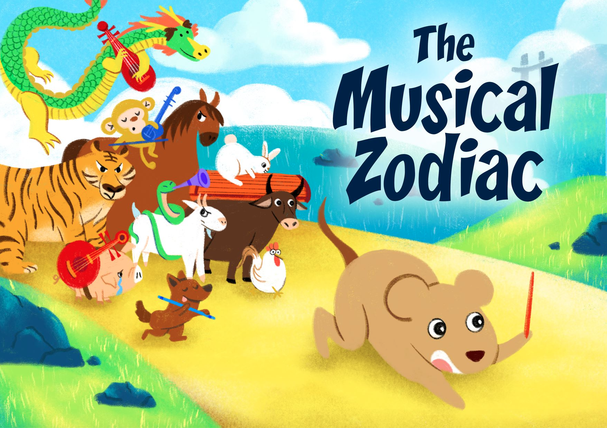

Slide 2
About the show
The Musical Zodiac
This performance includes both a theatrical duologue and also Chinese chamber music.
You will explore how music influences the movement, mood and set change of a theatre piece.
The musicians and actors will also take you through the journey of determining the champion of this celestial race.

Slide 3
About the Artist
Ding Yi Music Company
The Musical Zodiac is by Ding Yi Music Company. Established in 2007, Ding Yi Music Company is recognised as one of Singapore’s most prodigious Chinese chamber music ensemble. It captivates audiences with its distinctive approach to music making through a vast repertoire ranging from traditional Chinese music to contemporary avant-garde interpretations and cross-genre works.
Connect with Ding Yi Music Company at: www.facebook.com/dingyimusic/

Slide 4
What is Chinese chamber music?
Originating from Western classical music, Chinese chamber music is also known as 丝竹乐 (sī zhú yuè), which means silk and bamboo respectively.
It is a small ensemble that comprise of Chinese stringed (silk) and
wind (bamboo) instruments.
It started off as a folk ensemble, that first appeared around the
Ming dynasty (1368 – 1644).
Chinese Chamber gradually takes on both traditional and
contemporary repertoires.
Listen and watch the performance! How many Chinese instruments can you spot?

Slide 5
What is the Zodiac?
Watch the video and answer the questions on the next slide.
https://youtu.be/may2s9j4RLk
*click on the image to view the video

Slide 6
Buzz and Share
How many zodiac animals are there?
Which animal came in first in the race?
How did the first animal win the first place?
What are the five elements of the Chinese zodiac?
Which zodiac sign do you and classmates belong to?

Slide 7
MOOD
Feelings and emotions you have at a particular moment.
Sharing time!
What are some music you listen to and how does it make you feel?
*Allow students to share freely

Slide 8
MOOD
1. Listening examples
2. How does the following music make you feel?
(a)
(b)
(c)
Notes:
(a) River flows In you
(b) look down - les miserable
(c) Dynamite - BTS

Slide 9
Music brings you through
喜. 怒. 哀. 乐
Happiness
Anger
Sadness
Joy
Harmony, Tempo, Rhythm, Melody and Pitch, all these elements work together to create a wave of emotions.

Slide 10
Harmony is the sound of two or more notes heard simultaneously
Match what you hear to the EMOJI
Minor
Happy
Major
Sad
Notes:
https://youtu.be/wLoPelxUx4k

Slide 11
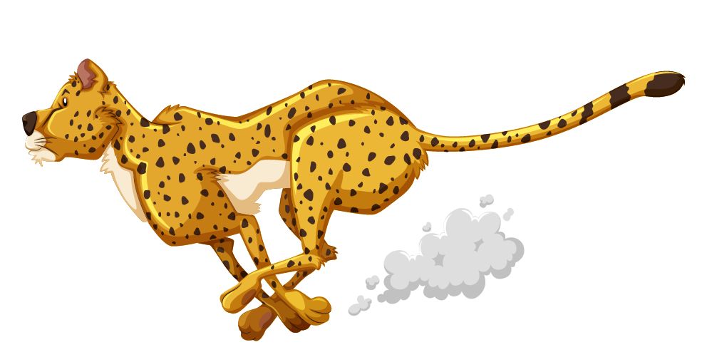
Tempo is the rate or speed of the song
Do you know?
Musicians use “musical language” to communicate.
Today we are going to learn three Italian terms describing tempo.
Grave
Slow and solemn mood
Andante
Walking pace
Allegro
Fast, lively

Slide 12
Rhythm is music's pattern in time
A slow beat tells that something sad or depressing is occurring, very fast beating has to do with excitement, while a dreamy rhythm with occasional upbeats can be a sign of love or joy.
In this performance, you will see how rhythms determine the movements of the animals!
Crawling
Let’s check out this example. Identify one movement that suits this rhythm.
Flying
Galloping
* Teachers to invite students to explain why they chose the movement

Slide 13
Melody is the tune
It is the part of the music that you often find yourself singing or humming along with. It is used as an expression of emotions.
Let’s create!
We will now invite a few classmates to hum a melody that last at least 5 secs. The melody can be from your favourite song, or you can create your own!
*Teachers to invite 2 to 3 students to hum a melody line, all melodies to be encouraged and appreciated.

Slide 14
Pitch is how high or low a note sounds
Low-pitch sounds evoke darkness, sadness, and tension.
High-pitch sounds make us feel happy.
Let’s create!
We will now invite a few classmates to hum a melody that:
• lasts at least 5 secs • has various high and low pitches
Do you know?
Catchy melodies often repeat the same series of notes over and over. An example would be the chorus of the songs you listen to.
*Teachers can invite another 2-3 students to perform melody line with contrasting pitches. All melodies are encouraged and appreciated.

Slide 15
Incidental Music
Music written to accompany a dramatic performance.
The music can be used to:
brighten the scene
create tension
create background for dialogue
enrich the character on stage
through changing its Har____, Tem___, Rhy____, Melo____, Pit ____

Slide 16
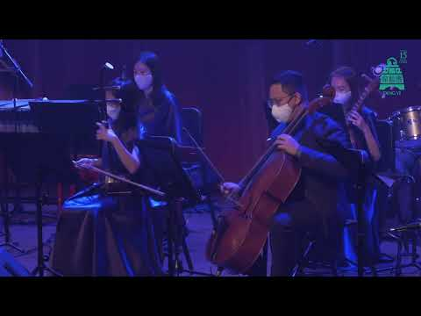
Suggested Activity 1
Listen and imagine…
Have a listen to this piece.
What emotions did you feel when listening to the music?
Which characters (human, animals etc.) might you imagine to be in the scene?
https://www.youtube.com/watch?v=xT5Ov4i52lc
*click on the image to view the video

Slide 17
3. How did the music change at 0:58?
4. How will the mood change?
https://www.youtube.com/watch?v=xT5Ov4i52lc
*click on the image to view the video

Slide 18
Fun facts!
Chinese instruments are versatile in their playing styles!
In this performance, listen out for how the following
Chinese instruments mimic the animals:

Slide 19
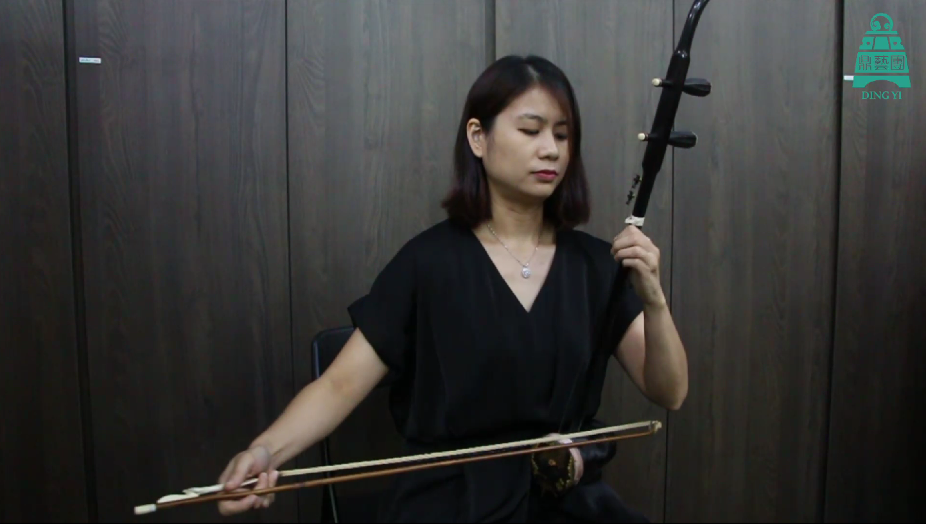
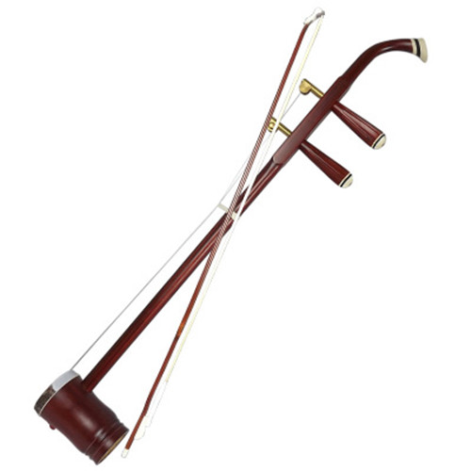
Fun facts!
*click on the image to view the video
Instrument: Gaohu 高胡
Animal: Rat
https://youtu.be/WEA2KhqOgv8
Notes:
https://youtu.be/WEA2KhqOgv8

Slide 20
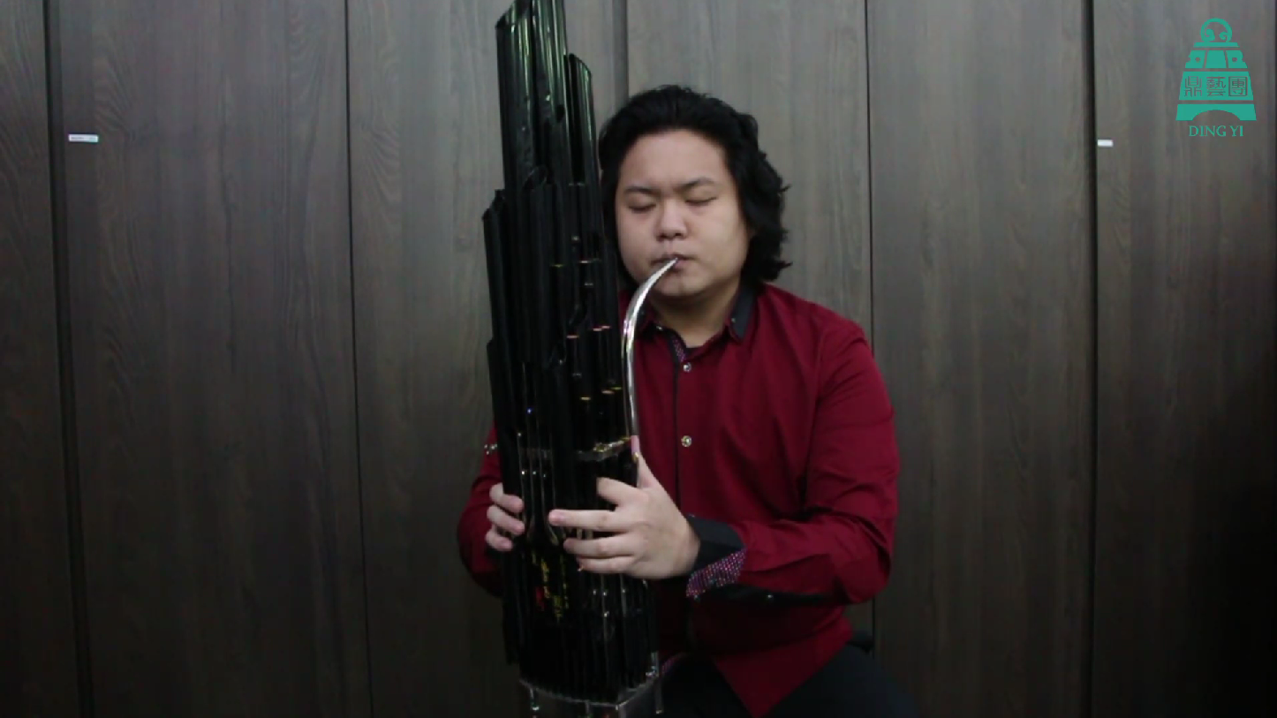
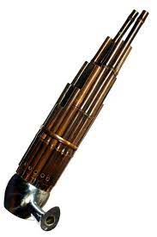
Fun facts!
*click on the image to view the video
Instrument: Sheng 笙
Animal: Dragon
https://youtu.be/AZC0BKbUOs8
Notes:
https://youtu.be/AZC0BKbUOs8

Slide 21
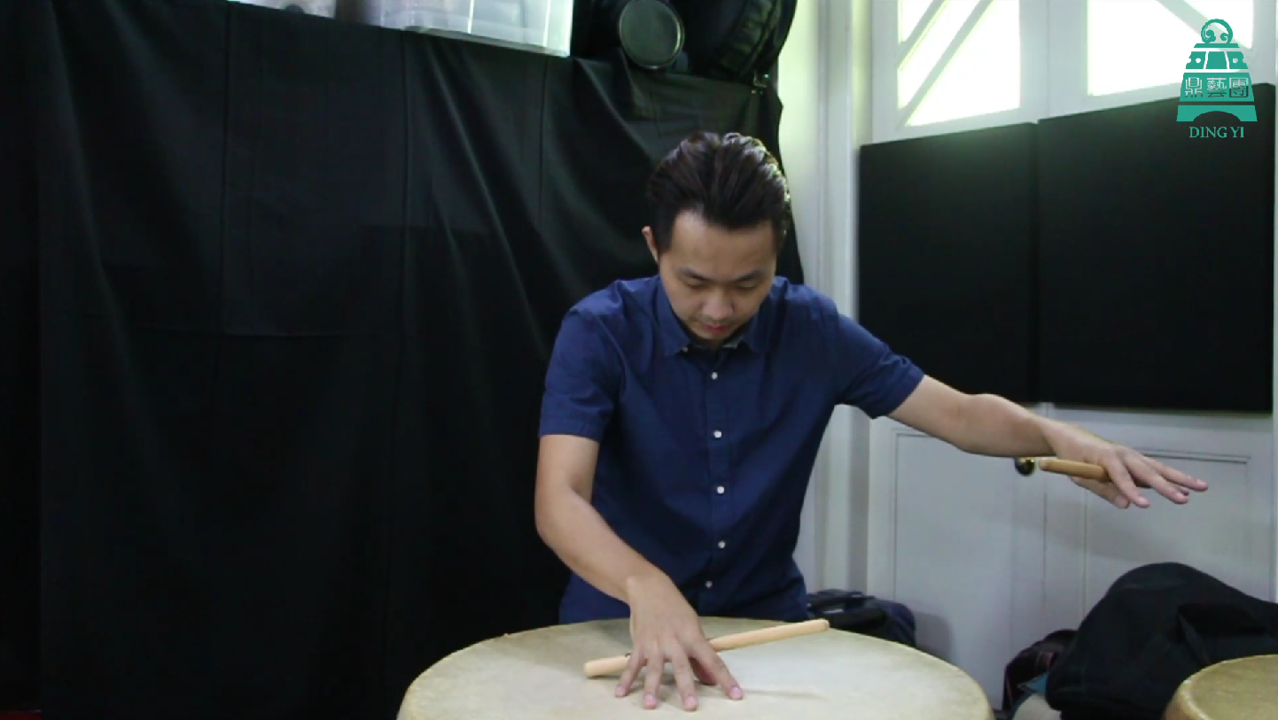
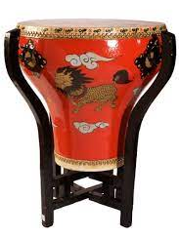
Fun facts!
*click on the image to view the video
Instrument: Dagu (Drum) 大鼓
Animal: Tiger
https://youtu.be/UqndDXby7pw
Notes:
https://youtu.be/UqndDXby7pw

Slide 22
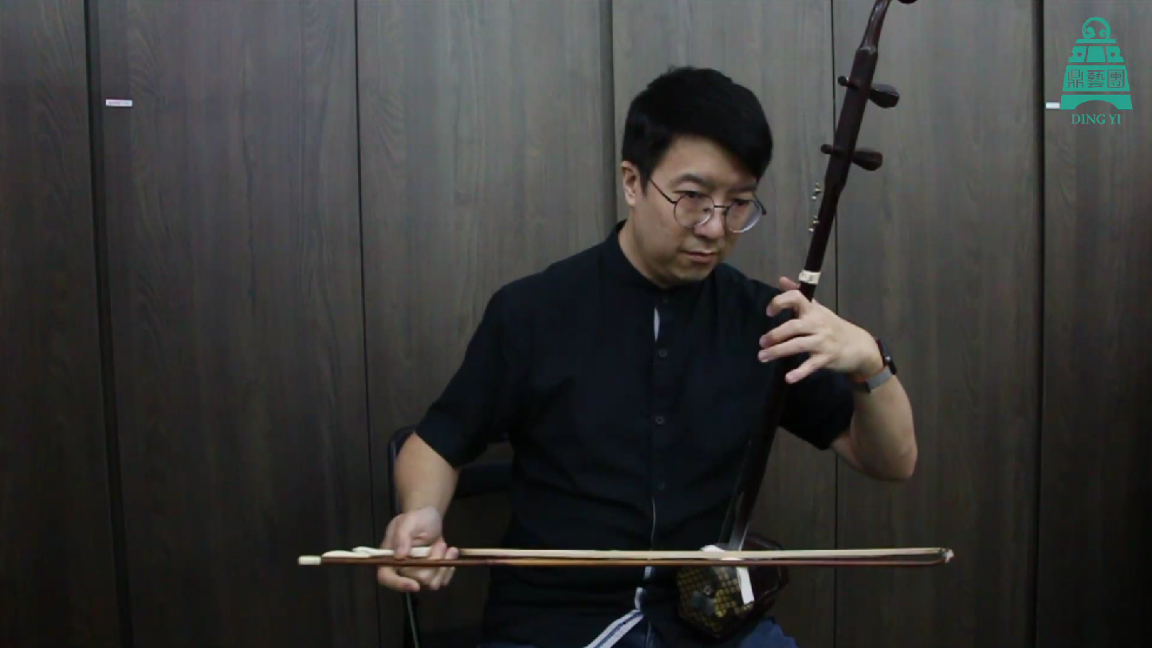
Fun facts!
*click on the image to view the video
Instrument: Erhu 二胡
Animal: Horse
https://youtu.be/NBawqgRjFAI
Notes:
https://youtu.be/NBawqgRjFAI

Slide 23
What is a duologue?
Additional Information [Drama]
A play with speaking roles for only two actors.
It is important for actors to listen and respond to the previous lines of the actor.

Slide 24
During the show
Listen out to how the Chinese chamber ensemble:
Represents different animals in the play
Create animal movement sounds through tempo, rhythms, pitches and dynamic
Create different moods for the scenes. How many different mood can you identify?
*Teachers may tune students’ attention to the change in harmony, tempo and rhythms.

